Slide 1
Written exam preparation

Slide 2
Module 1
The smarter way to learn how to drive

Slide 3
Passing a Bicyclist or Pedestrian
Navigation Menu
Signaling
Illinois Driver’s License
Emergency Vehicles
School Bus Safety
Driving Exam
Funeral Procession
Hill Parking
Responsibility of Driving
Traffic Stop
Prohibited Parking
School Zones
Right of Way
Construction Zones
Pedestrian
The smarter way to learn how to drive!
Driving Near Vehicles with Flashing Lights

Slide 4
Introduction
To navigate through the presentation, click the forward and back arrows on the screen.
We’re confident that you’ll find our Online Knowledge Preparation Exam efficient and effective mean.

Slide 5
Illinois Driver’s License
Back to Menu

Slide 6
To drive legally in Illinois, you must have a valid Illinois driver’s license, temporary visitor driver’s license, probationary license, instruction permit, Restricted Driving Permit or Monitoring Device Driving Permit.
To receive a driver’s license, you must:
• Visit a Driver Services facility, show required identification documents and have your photo taken.
• Surrender all Illinois or out-of-state licenses, state ID cards, instruction permits and commercial driver’s licenses.
• Pay the appropriate fee.
• Pass the appropriate exams (vision screening, written and/or driving).
Prior to getting a Driver’s License you may obtain a learner’s permit if you are looking to learn how to drive or if you are 15 yrs old.
Back to Menu

Slide 7
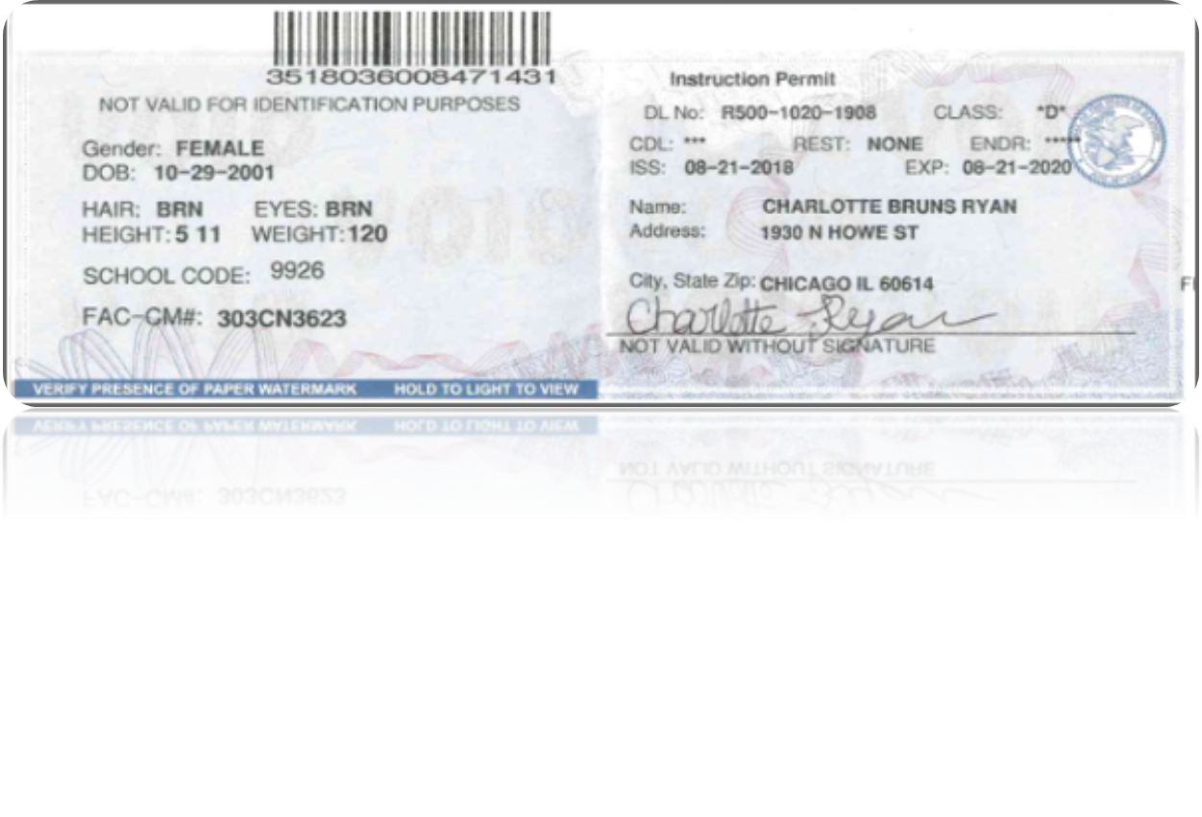
Getting Your Illinois Learner's Permit
The first step in the Graduated Driver’s License is to get your instruction permit, which is commonly referred to as a learner's permit.
Illinois has established age-related requirements for obtaining an instruction permit .
If you are 15 to 17 years old, you need to:
Be currently enrolled in a state-approved driver's education course.
Provide proof that you're a maximum of 30 days away from beginning a driver's education course.
Proof of identity/date of birth (State ID/US Passport, original birth certificate, adoption records, certified high school/grade school transcript).
Proof of Social Security (Social Security card, award letter, Illinois ID card record).
1 document proving residency (bank statement, report card, letter on school stationery).
Back to Menu

Slide 8
Your Driver's Ed course must include 30 hours of classroom instruction as well as 6 hours of behind-the-wheel instruction. Driver's Ed can be taken either at a high school or from a certified provider. Online Driver's Ed is not approved for Illinois at this time.
During this learner's permit phase of the GDL, you may only drive:
With 1 passenger in your front seat, and only as many passengers in the back seat as there are seat belts.
With your learner's permit in your possession. Failure to carry it will result in losing your eligibility for a driver's license until you are 18 years old.
And you may never drive:
Between the hours of 10 p.m. and 6 a.m., Sunday-Thursday.
Between the hours of 11pm and 6am, Friday and Saturday.
While using a cell phone at any time, unless you are in an emergency or need to report one. You are also never allowed to text and drive in any situation.
If you are 17 years and 3 months old or older, you may apply for a learner's permit without taking Driver's Ed.
Back to Menu

Slide 9
Taking the Written Permit Knowledge Exam in Illinois
The exam is composed of questions regarding traffic sign identification and road rules.
You'll need to:
Your permit validity varies based on age:
If you're under 18 years old, your permit is valid for 2 years and you must hold it a minimum of 9 months before you can apply for an initial driver's license.
If you're 18 years old or older, you'll receive an Illinois learner's permit that is valid for only 1 year.
Successfully pass the written permit test.
Pass a vision screening.
Pay the $20 fee.
Back to Menu

Slide 10
Driving Exam
• Be a properly licensed vehicle equipped for the driver’s license classification you are seeking and comply with Secretary of State vehicle condition standards including properly working brakes including the emergency brake, speedometer, headlights, brake and taillights, registration plate light, turn signals, windshield wipers, horn, rearview mirror and muffler.
• Be equipped with seatbelts.
• Be properly insured. Proof of insurance must be provided prior to the exam.
• Display valid front and rear Illinois license plates and a valid registration sticker. If the vehicle is registered outside of Illinois, it must meet the registration requirements of the respective state.
• Be driven to the facility by a driver who has a valid driver’s license/permit.
All drivers must take:
written exam every eight years, except those having no traffic convictions.
Drivers ages 75 and older and any driver turning 75 or older who is renewing his/her driver’s license must take:
Driving exam. If you have a traffic crash or other moving violation on your driving record, you may be required to take the written and/or driving exams.
First time drivers 21 or older, you may want to enroll in a community college or commercial driving school for adults. Idrivio can help you.
To take a driving exam, the vehicle you provide must:
Back to Menu

Slide 11
Driver’s License Age Restrictions — Drivers 16-21
The following exceptions apply:
• Age 16 or 17, you may receive your license you must complete:
*A state-approved driver education course Idrivio can help you with this course.
*50 hours of practice driving and
*Hold permit for 9 months
* Pass vision, written and road exam.
You must be at least age 18 to obtain an Illinois driver’s license.
Back to Menu

Slide 12
Driver’s License Age Restrictions — Drivers 16-21
• Age 18, 19 or 20 who has never been licensed or completed an approved high school or commercial school driver education course, you must:
* Complete a six-hour adult driver education course certified by Secretary of State before obtaining a license. Idrivio can help you with this course.
• Drivers under age 21 are not allowed to drive any vehicle for-hire that is transporting more than 10 passengers, or drive a commuter van, religious organization bus, school bus, vehicle transporting senior citizens or child care vehicle.
If a parent cannot accompany a minor to the facility, an Affidavit/Consent for Minor to Drive must be signed by a legal guardian or a responsible adult over age 21.
Back to Menu

Slide 13
Responsibility of driving
Back to Menu

Slide 14
Responsibility of Driving
When you are issued a driver’s license, you are also issued a great deal of responsibilities.
You must continue to demonstrate your ability to drive safely on the road. If you fail to demonstrate this ability, you will be issued traffic tickets, or even have your license suspended or revoked.
You must drive safely, obey traffic laws, and respect the rights of other drivers.
Not only should you concentrate on your own driving, you should also be well aware of the other vehicles around you. Driving safely also includes how and where you park your car. Passengers in your car put their safety in your hands and expect you to drive safe as well.
Back to Menu

Slide 15
License Classifications
Driver’s licenses are classified by the gross vehicle weight rating (GVWR) of your vehicle. The classifications for large vehicles (and motorcycles, by engine size) are:
Class A & B: Any motor vehicle with a GVWR of 26,001 lbs. or more (CDL)
Class C: Any motor vehicle with a GVWR of 16,001 lbs. or more but less than 26,001 lbs.
Class D: Any motor vehicle with a GVWR of 16,000 lbs. or less. (such as a car, pickup truck, SUV, or van). Regular DL
Class L: Motor-driven cycle with less than 150cc engine
Class M: Motorcycle or motor-driven cycle
Back to Menu

Slide 16
Distracted driving
Back to Menu

Slide 17
Illinois law prohibits the use of hand-held cellphones while driving.
Hands-free and Bluetooth technology are allowed for drivers age 19 and older.
Back to Menu

Slide 18
Even using hands-free technology is considered a distraction while driving and can be dangerous. If you must make a phone call, even with hands-free technology, it is recommended that you pull off to the side of the road before making the call.
Back to Menu

Slide 19
Safety belt law
Back to Menu

Slide 20
Illinois law requires all drivers and passengers (front and back seat) age 8 and older to wear safety belts even if the vehicle is equipped with air bags.
Passengers under age 8 must be secured in an appropriate child restraint system as covered by the Child Passenger Protection Act.
Back to Menu

Slide 21
When riding in a truck with only a front seat equipped with safety belts, a child under age 8 must be secured in an appropriate child restraint system.
Note: Seat belt use/child restraint use is required in all seating positions in a vehicle.
Back to Menu

Slide 22
Additional Areas for Reduced Speeds
Drivers should reduce speed near intersections and on hills, curves, shaded areas (due to possible ice in winter), and narrow roads in order to be safe.
The presence of pedestrians, traffic, weather, mechanical problems or road conditions can add to the level of risk on the road.
Limited visibility on hills requires drivers to travel at lower speeds.
Back to Menu

Slide 23
Speed Limits in Illinois
Driver’s licenses are classified by the gross vehicle weight rating (GVWR) of your vehicle. The classifications for large vehicles (and motorcycles, by engine size) are:
You may drive at the maximum allowable speed only under safe conditions. For safety purposes, a minimum speed limit may be posted along certain roadways.
When minimum limits are not posted, drivers should not drive so slow as to create an interference with the normal movement of traffic.
The following speed limits apply, unless otherwise posted:
Interstates and tollways — 70 mph.
Highways with four lanes — 65 mph.
Other highways and rural areas — 55 mph.
City/Town Areas — 30 mph.
Alleys — 15 mph.
School Zones — 20 mph (on school days between 7 a.m. and 4 p.m. when children are present and signs are posted).
Back to Menu

Slide 24
School Zones
Back to Menu

Slide 25
When approaching a marked school zone (typical school hours are 7 a.m.-4 p.m.) on days when school is in operation and children are present [e.g., visible outdoors, near school grounds], a driver must:
Discontinue wireless/cell phone use (unless using a hands-free device that may include the use of a single-sided headset),
Reduce speed to 20 mph, and
Stop and yield the right-of-way to any children or adults in the crosswalk area.
Back to Menu

Slide 26
Construction zones
The following slides provide an overview of what to do to stay safe—and avoid traffic citations— when driving in work zones
Back to Menu

Slide 27
When approaching or entering a highway construction or maintenance area (also known as a work zone), Illinois law requires motorists to slow down, discontinue wireless/cellphone use (unless using a hands-free device that may include the use of a single-sided headset), yield to any authorized vehicles or workers in the area, change to a lane away from the workers when possible, and proceed with caution.
Back to Menu

Slide 28
Driving Near Vehicles with Flashing Lights
Motorists have to follow a series of steps to ensure their safety—and workers’ safety—when driving near a vehicle displaying rotating, oscillating, or flashing lights.
When approaching a stationary emergency/maintenance vehicle using visual signals (such as flashing lights), Illinois law requires motorists to yield, change to a lane away from the emergency workers when possible to leave a “buffer zone” between their car and the workers, and proceed with caution. This is sometimes called the “move over” law. If a lane change is not possible, reduce speed and proceed with caution.
Back to Menu

Slide 29
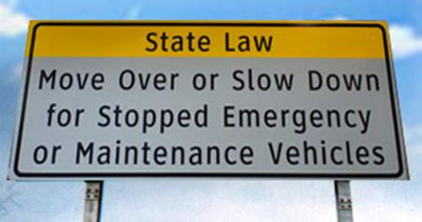
The “move over” law is designed to ensure the safety of everyone who is working or driving near an emergency or maintenance vehicle.
Back to Menu

Slide 30
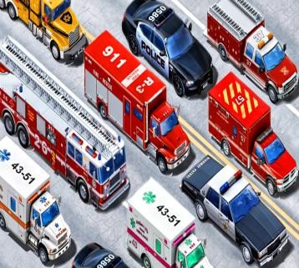
Drivers in Illinois are required to leave a “buffer zone” between their car and any vehicle on the shoulder that is displaying flashing lights. This includes cars on the shoulder displaying hazard flashers as well as other vehicles with flashing lights, including tow trucks, police and fire vehicles, motorist assistance vehicles, and highway maintenance vehicles.
Back to Menu

Slide 31
Emergency Vehicles: Pull to the Right for Sirens and Lights
Back to Menu

Slide 32
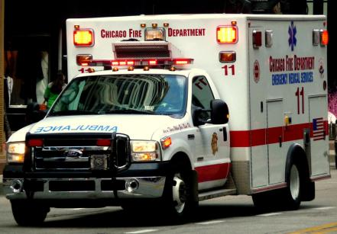
When being approached by an emergency vehicle using audible and visual signals (lights and/or sirens), Illinois law requires motorists to immediately pull to the right side of the road and allow the emergency vehicle to pass.
Back to Menu

Slide 33
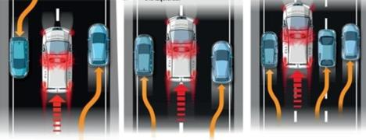
In some cases a complete stop may be necessary to allow the emergency vehicle to pass. If stopped at an intersection with two-way traffic, remain stopped until the emergency vehicle passes.
Back to Menu

Slide 34
Funeral Procession Safety
Motorists encountering a funeral procession must yield the right-of-way to all vehicles in the procession.
Motorists must NOT drive between vehicles in an organized funeral procession, except when required to do so by a law enforcement officer; must NOT join a funeral procession for the purpose of securing the right-of-way; or attempt to pass any vehicle in an organized funeral procession, except where a passing lane has been specifically provided.
Back to Menu

Slide 35
Traffic Stop Safety
Back to Menu

Slide 36
When stopped by a police officer or state trooper:
slow down, activate your right turn signal, pull to the right side of the road, and stop as soon as possible when you see a police vehicle’s flashing lights in your rear-view mirror.
If the police officer follows your car specifically, you can assume that the officer has initiated a traffic stop.
Activate your hazard flashers as you look for a safe location to stop your car.
If you cannot find a safe location to immediately pull over due to construction work, closed shoulders, or other obstructions, drive slowly until a safe location is available. Remember that the officer expects you to pull over as soon as it is safe to do so.
Place your gear selector in Park if you are driving an automatic transmission vehicle.
If you are driving a manual transmission vehicle, place the transmission in Neutral and set the parking brake.
Turn off the radio/sound system so that you can focus your full attention on the officer.
Conclude any cell phone call before the officer reaches your vehicle.
Eliminating audio distractions demonstrates that you are ready to listen to the police officer’s directions and that you respect his or role as a law enforcement officer.
As you wait for the officer to approach your vehicle, lower your window.
Back to Menu

Slide 37
Do not reach for your driver’s license, insurance card, or registration card until the police officer reaches your vehicle and asks you to present a specific document. The officer might think that you are reaching for a concealed weapon or are attempting to hide illegal items.
After lowering your window, turn your ignition to the “Off” position and place the keys on the dashboard.
Keep your hands on the steering wheel, and ask your passengers to keep their hands visible, as well. Keeping your hands visible shows the officer that you are not attempting to reach for a weapon or other item.
If your car has an interior light, such as a dome light, turn on the light to increase the level of illumination inside the vehicle if you are stopped at night. In dark conditions, officers will shine their patrol car’s spotlights toward your car so that they can see inside the vehicle for their protection.
If your car has an interior light, such as a dome light, turn on the light to increase the level of illumination inside the vehicle if you are stopped at night. In dark conditions, officers will shine their patrol car’s spotlights toward your car so that they can see inside the vehicle for their protection.
Do not step out of the vehicle unless the officer instructs you to do so. This step is necessary to protect the officer’s safety. Getting out of the vehicle can be perceived as aggressive behavior and a threat to the officer’s safety.
Back to Menu

Slide 38
Right-of-Way
Back to Menu

Slide 39
Right-of-way laws help keep order on the roads. A driver must yield the right-of-way to other drivers or pedestrians:
When making a right turn on a red light after a complete stop.
After coming to a complete stop at an intersection where there is a stop sign or flashing red signal. If there is no stop line, stop before the crosswalk. If there is no crosswalk or stop line, stop at a place where all approaching traffic can be seen.
Back to Menu

Slide 40
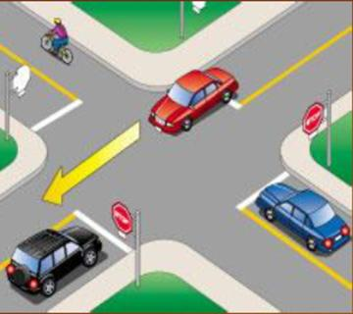
Who gets to go first when multiple cars are present at an intersection?
When more than one driver reaches a four-way stop intersection, the first driver to stop should be the first to go.
When two vehicles on different roadways arrive at a four-way stop intersection at the same time, the vehicle on the left should yield to the vehicle on the right.
Back to Menu

Slide 41
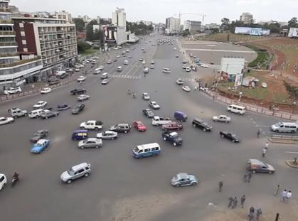
When two vehicles on different roadways reach an uncontrolled intersection (no traffic signs) at the same time, the vehicle on the left should yield to the vehicle on the right.
When two cars are stopped at an intersection with one driver signaling a left turn and the other car going straight ahead, the person who wants to turn left should wait for the person who is going straight to clear the intersection. Once it is clear, the driver turning left is allowed to turn.
Back to Menu

Slide 42
Pedestrian Right-of-Way
Back to Menu

Slide 43
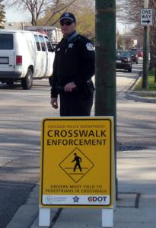
A driver must come to a complete stop (and yield):
When a pedestrian is in an unmarked crosswalk on the driver’s side of the roadway and there are no traffic control signals.
When making a turn at any intersection.
When making a lawful turn on a red light after coming to a complete stop.
When a pedestrian is in a marked crosswalk.
On school days, when children are in close proximity to a school zone crosswalk.
A driver must yield to a pedestrian:
Back to Menu

Slide 44
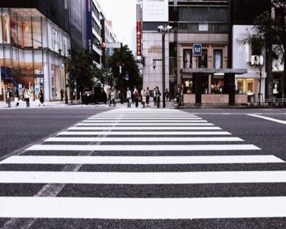
A driver must yield to a pedestrian:
After coming to a complete stop at a stop sign or flashing red signal at an intersection.
When a pedestrian enters a crosswalk before the traffic light changes.
When a pedestrian is walking with a green light, to a walking person symbol or a walk signal.
When a pedestrian is leaving or entering a street or highway.
Back to Menu

Slide 45
Passing on Two-Lane Roads
Back to Menu

Slide 46
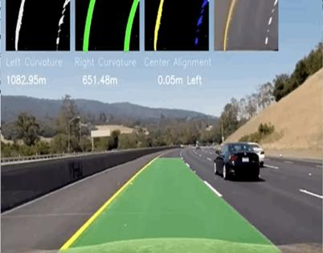
A driver must use caution when passing another vehicle. On a two-lane highway, the left lane should be clearly seen and free of oncoming traffic for a distance great enough to permit passing.
Do not turn back into the right-hand lane until you can see the entire vehicle you have just passed in your rearview mirror.
When passing a vehicle, you must return to your lane before you get within 200 feet of an oncoming vehicle. The driver you are passing must not increase speed until you have completed your passing.
Driving off the pavement or main traveled part of the road is not allowed when passing another vehicle on the right or the left.
Back to Menu

Slide 47
Passing on a two-lane, two-way roadway is not allowed:
In an area marked for no passing by a solid yellow line on your side of the center of the roadway or a DO NOT PASS or NO PASSING ZONE sign.
On a hill or curve where it is not possible to see oncoming vehicles.
Within 100 feet of an intersection or railroad crossing.
When the view is blocked within 100 feet of any bridge, viaduct or tunnel.
When a vehicle has stopped at a crosswalk or intersection to allow a pedestrian to cross.
In a construction zone. All construction zones in Illinois are no passing zones.
Note: Passing is also prohibited in school zones and near school buses that are loading or unloading passengers.
Back to Menu

Slide 48
Passing a Bicyclist or Pedestrian: 3 ft. Rule
Back to Menu

Slide 49
Signaling
Turn Signals: In a business or residential area you must give a continuous turn signal for at least 100 feet before turning. In other areas the signal must be given at least 200 feet before turning.
Back to Menu

Slide 50
School Bus Safety
Back to Menu

Slide 51
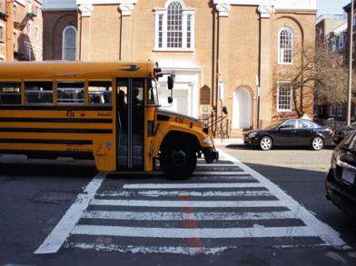
In most cases, motorists have to come to come to a complete stop for a school bus that has activated its flashing lights and has extended its stop-arm.
There is one exception, though, which is listed below:
On a four-lane roadway where a bus is stopped in the opposite direction from which you are traveling, you are not required to stop your vehicle but you should drive with caution.
Back to Menu

Slide 52
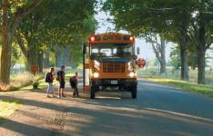
In most cases, though, motorists are required to stop for school buses displaying red, flashing lights. Some examples are below:
If you are driving in the same direction as the bus on a four-lane road, you must stop when the red lights are flashing and the stop signal arm is extended.
In addition, on two-lane roads, private roads, and parking lots, you must stop before meeting or overtaking (passing) a school bus loading or unloading passengers.
A warning will be given at least 100 feet (200 feet in rural areas) in advance of a stop. The bus driver will flash amber and red lights on the front and rear of the bus.
The stop signal arm will be extended after the school bus has come to a complete stop. You must then come to a complete stop. You must remain stopped until the stop signal arm is no longer extended and the flashing lights are turned off or the driver signals you to pass.
Your driver’s license or vehicle registration will be suspended [for one month to three months] and you will pay a minimum $175 fine if you are convicted of illegally passing a stopped school bus.
Back to Menu

Slide 53
Railroad Crossing Safety
When approaching a controlled railroad crossing (which features lights and/or gates) or an uncontrolled railroad crossing (no lights or gates) and the devices are not activated, you should slow down and look in both directions on the track for oncoming trains or railroad equipment.
If safe to do so, proceed with caution across the railroad crossing.
Back to Menu

Slide 54
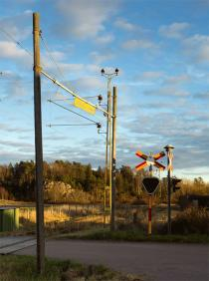
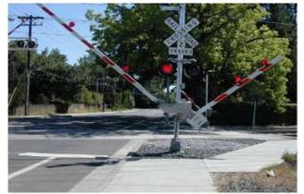
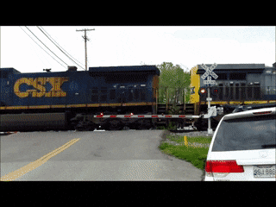
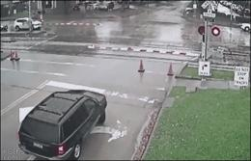
A driver must come to a complete stop (and yield):
Proceed only after the gate is all the way up, the lights are no longer flashing, and you have visually checked all the tracks for any additional oncoming trains or railroad equipment.
Before crossing the tracks, make sure that there is enough room on the other side of the tracks so that you do not end up stuck on the tracks—and in the path of a train. If you are not certain that enough space exists, don’t cross the tracks.
At a controlled crossing (featuring lights and gates), you must stop if the crossing gate is lowered or a signal is flashing.
Drivers should stop 15-50 feet away from the crossing if there is a stop sign, the electric signal is flashing, or the crossing gate is lowered.
A driver must yield to a pedestrian:
Back to Menu

Slide 55
Stop Before Entering Road When Leaving Parking Lot or Driveway
In urban areas, drivers must come to a complete stop before entering the sidewalk area when moving out of an alley, building, private road or driveway. If there is no sidewalk, stop at a point nearest the street or roadway where there is a view of approaching traffic. After stopping, yield the right-of-way to pedestrians and all vehicles.
Back to Menu

Slide 56
Hill Parking
Any time you park on a hill, you should put the gear selector in park and set the parking/emergency brake if necessary. When starting your vehicle from an uphill or downhill location, you should release the parking/emergency brake, activate the correct directional (turn) signal, check for traffic, and proceed when it is safe to do so.
Back to Menu

Slide 57
If you park on a street with curbing and your vehicle is facing downhill, turn the front wheels toward the curb so your vehicle will roll toward the curb.
If you park your vehicle facing uphill and there is a curb, turn the front wheels away from the curb.
If you park on a street without curbing, turn the wheels toward the side of the road on which you are parked.
Hint: For uphill parking, think of the phrase “up, up, and away”; you’ll turn your wheels away from the curb when parking uphill on a road where a curb is present.
Back to Menu

Slide 58
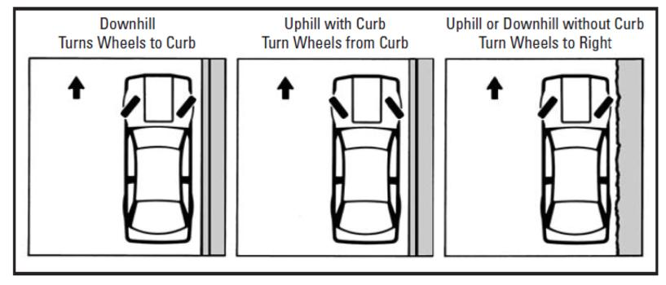
Note: When parking on roads where curbs are present, drivers must park within 12 inches of the curb. Cars must be parked in the same direction as the flow of traffic.
Back to Menu

Slide 59
Prohibited Parking
Standing or parking a vehicle, whether occupied or not, is prohibited:
In front of a public or private driveway.
Within 15 feet of a fire hydrant.
Within 20 feet of a fire station driveway or crosswalk at an intersection.
Within 30 feet of a STOP sign, YIELD sign or traffic control signal.
Back to Menu

Slide 60
Dropping Off Passengers
When dropping off passengers at the curb, drivers should remind their passengers to exit on the curb side rather than on the street side.
Exiting on the curb side reduces the chance of a collision between the person leaving the vehicle and a car, motorcycle, or bicycle in the traffic lane.
Back to Menu

Slide 61
Thank you!
support@idrivio.com
www. Idrivio.com

